Slide 1
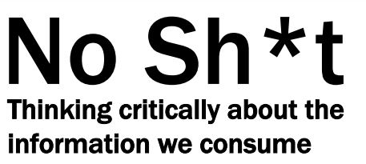
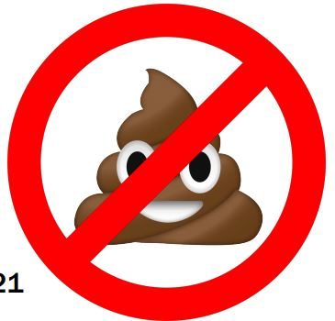
Chelsea Jordan-Makely, MLIS

Slide 2
Agenda
Mapping the online information environment
  fake news, misinformation and disinformation, propaganda, lies, satire, and clickbait
  Tools for evaluating information
  CRAAP framework, critical thinking, online resources
Bonus: Carl Sagan and “The Fine Art of Baloney Detection”

Slide 3
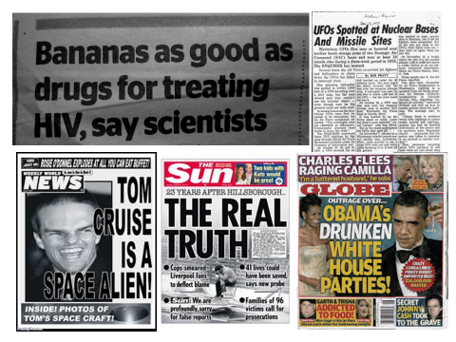

Slide 4


Slide 5
Definitions
1. Fake news
Fake news is information that is clearly and demonstrably fabricated and that has been packaged and distributed to appear as legitimate news. This narrow definition seeks to distinguish fake news from other types of misleading information by clarifying that the former is patently false and was created and presented in a way meant to deceive consumers into thinking it is real. Fake news refers to a specific piece of information; it does not refer to any particular type of news outlet, individual, or other actor.

Slide 6
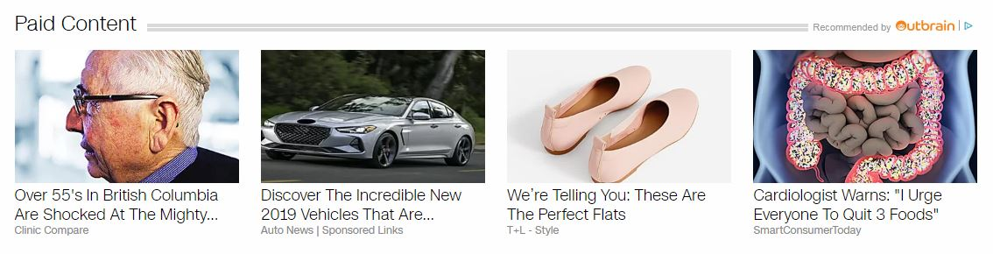
2. Clickbait
Clickbait is content whose main purpose is to attract attention and encourage visitors to click on a link to a particular web page.

Slide 7
3. Misinformation
Misleading or out-of-context information does not on its own constitute fake news. This kind of information is not wholly fabricated, and it can exist within a news report that is based on actual events that occurred.

Slide 8
4. Disinformation
Disinformation is false information spread deliberately to deceive.

Slide 9
5. Propaganda
Propaganda is misleading or highly biased information that is specifically designed to confirm or promote a particular ideological viewpoint. Propaganda is distinct from fake news in that it originates from politically motivated actors with the intention of driving public discussion, apart but not separate from financial and ideological gain.

Slide 10
6. Lie
A lie is a false statement made with deliberate intent to deceive; a falsehood.

Slide 11
7. Satire
Satire is writing or art designed to make social commentary based on mockery and imitation of real-life events or actors. Satire is different from fake news in that its purpose is to entertain or inspire consumers, rather than to deceive them. An example of legitimate satire is The Onion, which is widely known and transparently presented as such.

Slide 12
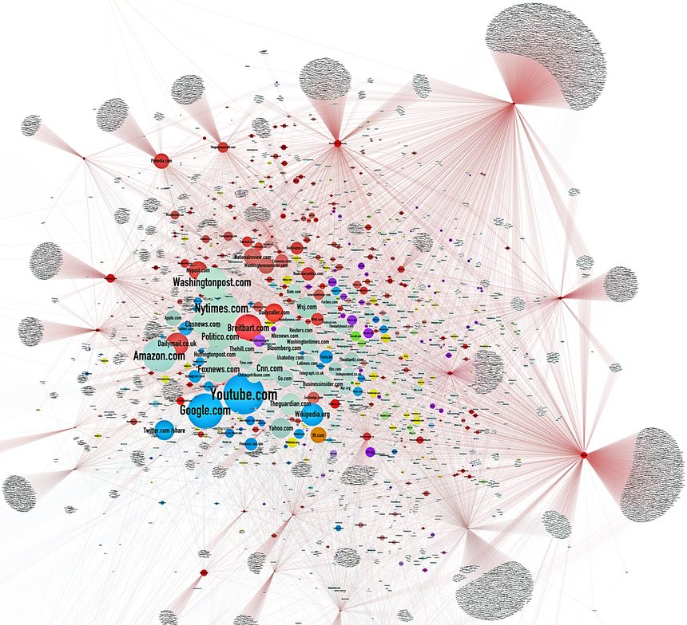

Slide 13
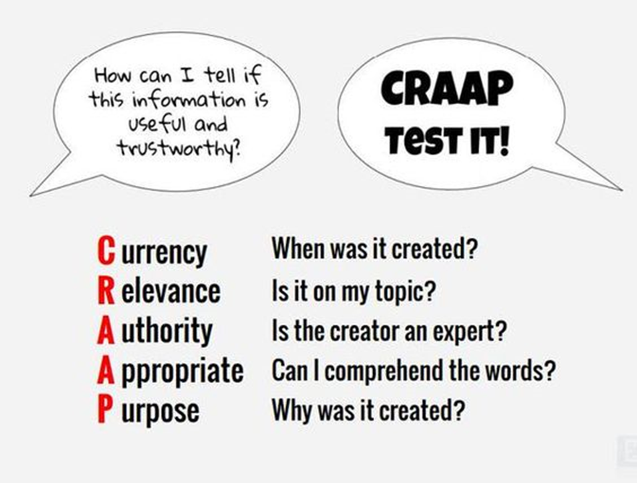

Slide 14
Media Literacy Resources
B.S. Detector (bsdetector.tech)
FactCheck.Org
MediaBiasFactCheck.com
MediaMatters.org
Snopes.com
Toronto Public Library guide to spotting fake news

Slide 15


Slide 16

Chelsea Jordan-Makely, MLIS
Technology & Support Services Librarian
Whistler Public Library
cjordan-makely@whistlerlibrary.ca

